Slide 1
Jermyn Borough Council Meeting
9/16/21

Slide 2

Meeting Agenda
Call to Order
Pledge of Allegiance
Roll Call
Previous Meeting Minutes
Treasurer’s Report/Bills Payable
Correspondence
Public Comment
Professional Reports
Committee Reports
Borough Manager Report
Old Business
Mark Kilmer Property Issue
Budget Discussion
County Waste Performance
Bacon & Dwight Ave Projects
Civil Service Commission Ordinance
Police Pay
Old Mill Rd
Executive Session - Personnel
New Business
Adjournment

Slide 3
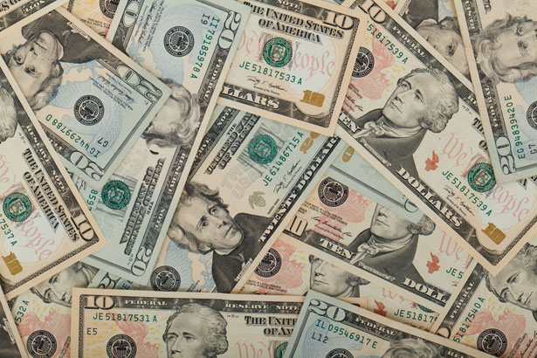
Treasurer’s report
9/16/21
ASSETS
Checking/Savings
American Rescue Plan Fund 107,447.72
Capital Reserve - DPW 10,513.87
Capital Reserve - Police 4,486.82
Crime Watch Fund 805.44
General Fund - Community 180,339.24
General Fund - FNB 3,979.15
Holiday Lights Fund 940.14

Slide 4
Treasurer’s report
Investment - General Fund 1,001.56
Investment - Liquid Fuels 33,815.19
Investment - Paving Fund 1,011.92
Investment - Recycling 5,003.59
Investment - Refuse 2,600.31
Liquid Fuels - FNB 49,312.33
Petty Cash 153.42
Recreations Fund 14,240.25
Recycling - Community 8,673.76
Refuse Checking - FNB 101,870.16
Total Checking/Savings 526,194.87

Slide 5
Treasurer’s report
200000 · Accounts Payable 38,045.87

Slide 6
Account | September, 2018 | September, 2021 | Change
American Rescue Plan | Did Not Exist | $107,447.72 | $107,447.72
Capital Reserve - DPW | $59,441.73 | $10,513.87 | -$48,927.86
Capital Reserve - Police | Did Not Exist | $4,486.82 | $4,486.82
Crime Watch | Unknown | $805.44 | $805.44
General Fund - Community | $26,209.84 | $180,339.24 | $154,129.40
General Fund - FNB | $398.41 | $3,979.15 | $3,580.74
Holiday Lights | $1,348.85 | $940.14 | -$408.71
Investment - General Fund | $1.39 | $1,001.56 | $1,000.17
Investment - Liquid Fuels | $43,994.79 | $33,815.19 | -$10,179.60
Investment - Paving | $11.43 | $1,011.92 | $1,000.49
Investment - Recycling | $1.33 | $5,003.59 | $5,002.26
Investment - Refuse | $0.00 | $2,600.31 | $2,600.31
Liquid Fuels | $69,271.69 | $49,312.33 | -$19,959.36
Petty Cash | Unknown | $153.42 | $153.42
Recreation | Unknown | $14,240.25 | $14,240.25
Recycling | $7,546.69 | $8,673.76 | $1,127.07
Refuse | $100,447.58 | $101,870.16 | $1,422.58
Total | $308,673.73 | $526,194.87 | $217,521.14
Total Munus ARP Funding |  | $418,747.15 | $110,073.42

Slide 7
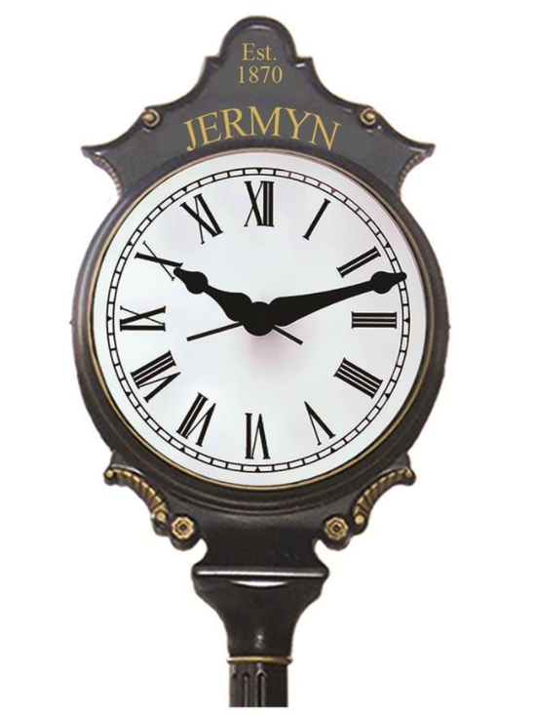

Slide 8
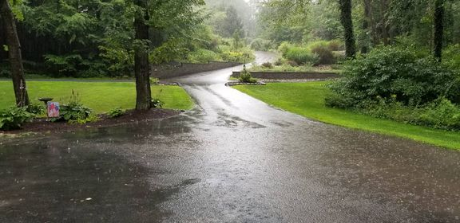

Slide 9
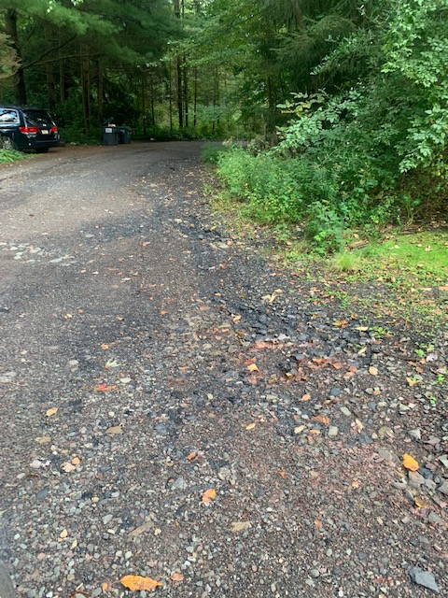

Slide 10
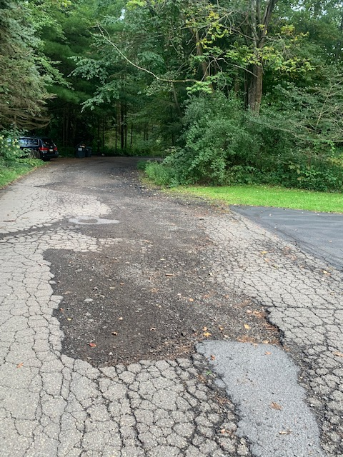

Slide 11
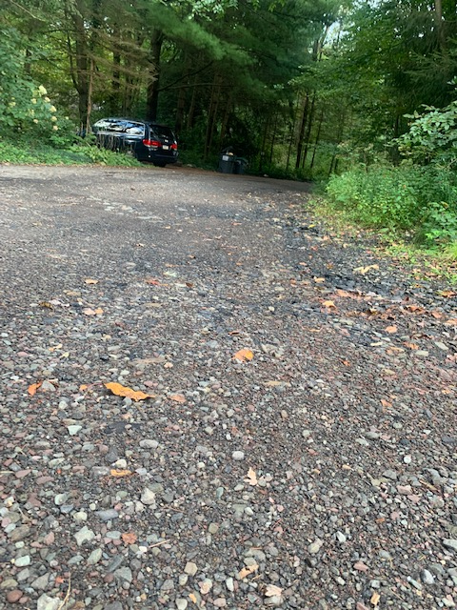

Slide 12
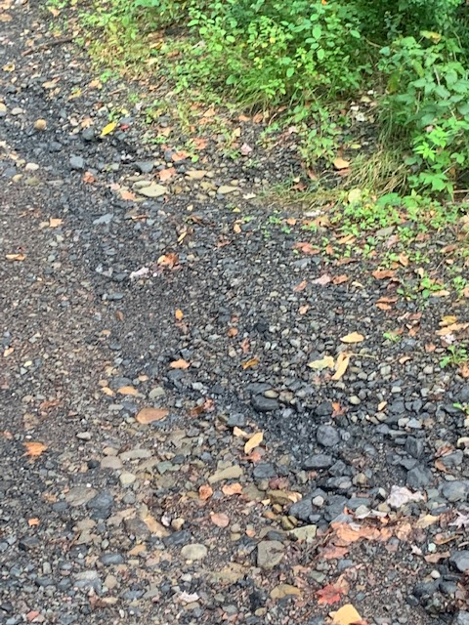

Slide 13
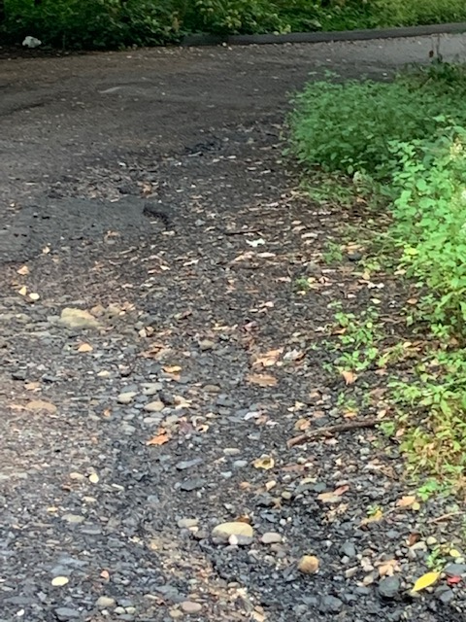

Slide 14


